Slide 1
Bellville High School
Dress Code

Slide 2
The Rules
Students are expected to arrive to school in dress code and remain in dress code until they leave at 3:25.

Slide 3
Types of Images and Sayings allowed on clothes

Slide 4
Types of Images and Sayings NOT allowed on clothes
Anything that references drugs, alcohol, or violence is not allowed including items that directly or indirectly reference sexual orientation, racial slurs, gender slurs or derogatory language deemed inappropriate by the administration.

Slide 5
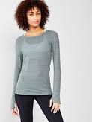
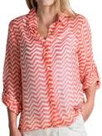
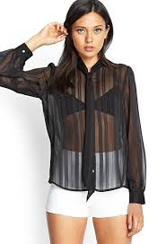
See through shirts are only allowed over clothing that completely covers mid-drift, cleavage and undergarments.
No:
Yes:
Tank tops and spaghetti straps are allowed ONLY if they also cover mid-drift, cleavage and undergarments and are covered by another acceptable sweater or jacket, including a sheer top.

Slide 6
Bras must be worn, but not be visible
No:
This includes sports bras and colored bras that can be seen through a shirt!

Slide 7
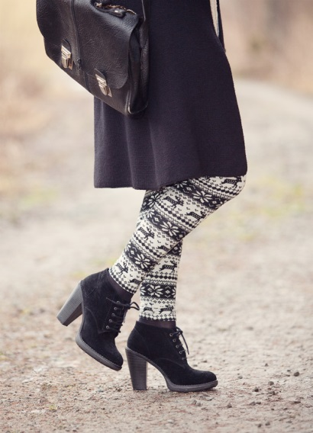
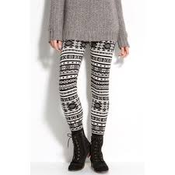
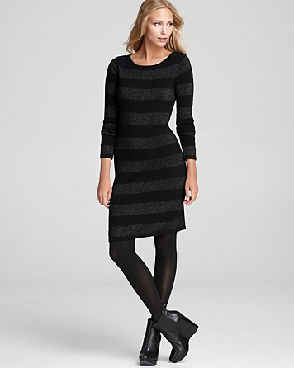
Leggings and long shirts
No:
Yes:
Leggings under shorts and skirts are only
allowed if the shorts or skirt is no shorter than
4 inches above the knee.
Leggings, form fitting wear or yoga pants may only be worn under tops that are no
shorter than 4 inches above the knee.

Slide 8
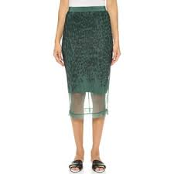
See through skirts can be worn over dress code length skirts, shorts or pants.
No:
Yes:

Slide 9
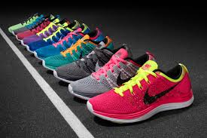
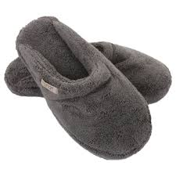
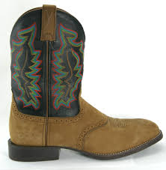
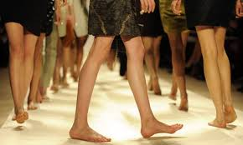
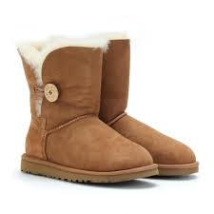
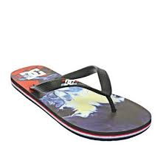
Appropriate Footwear
No:
Yes:

Slide 10
Mid-drifts can’t show AT ALL skin must be fully covered all the way around
NO:

Slide 11
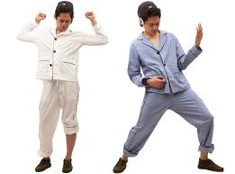
Keep Pajamas & Swimwear at home!
NO:

Slide 12
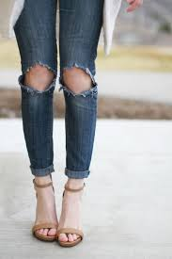
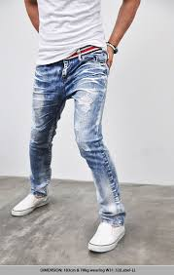
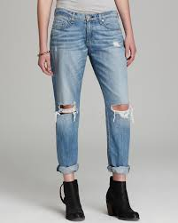
How to wear your jeans at school: No holes or frays allowed!
No:
Yes:

Slide 13
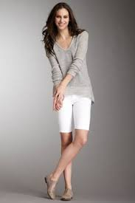
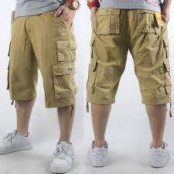
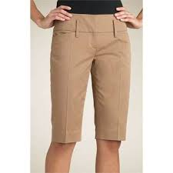
How to wear your shorts at school: No cutoffs!
No:
Yes:

Slide 14
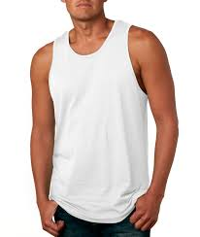
Muscle shirts?? Just say NO.
Boys sleeveless shirts are not allowed.
Girls tank tops are not allowed but may be worn under an appropriate cardigan or school accepted cover.

Slide 15
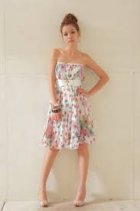
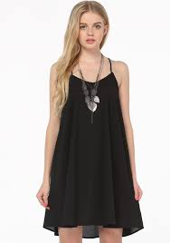
Accepted TOPS No Strapless or spaghetti straps. bras may not show. Shirts must come to edge of shoulder.
No:
Yes:

Slide 16
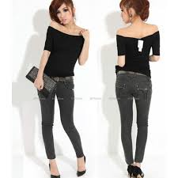
Low cut, Halter, Tube or Off-the-shoulder tops are not permitted
NO:
Cleavage should not be seen! If shirt dips to where it can be seen, wear something underneath to cover it.

Slide 17
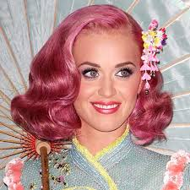
Hair styles
No:
Must be neat, clean and well-groomed
Not disruptive
Must be one natural hair color
Boys hair must be above collar of a dress shirt

Slide 18
Facial Hair
No:
Yes:
or
All boys must be clean shaven each day. Mustaches and beards are not permitted.

Slide 19
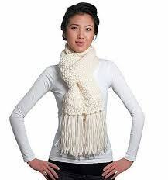
Hats, hoodies and sunglasses: Anything covering your face or head must be removed when entering the school
No:
Yes:

Slide 20
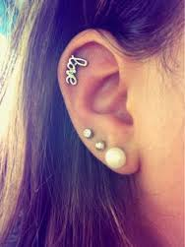
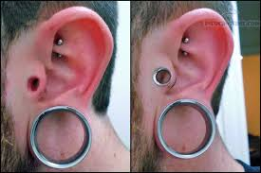
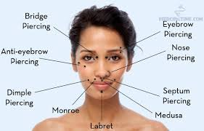
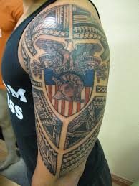
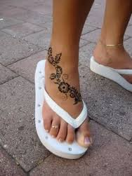
Piercings and Tattoos
Yes:
No:
Girls may have earrings in each ear.
No other visible piercings are allowed.
Boys may not wear piercings.
Clear spacers may be used to fill in existing holes.
All tattoos must be covered at all times

Slide 21
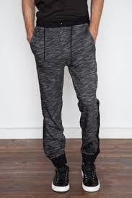
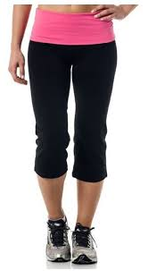
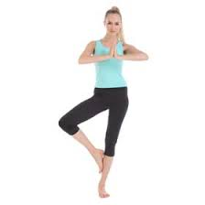
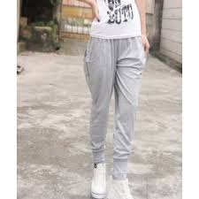
Athletic wear
No:
Yes:

Slide 22
Pull Up Your Pants
NO:
Pants must be worn around the waist area with underclothes not being seen!
All of these are examples of Rule Violations

Slide 23
Thanks for reviewing our school policy!
The administration reserves the right to judge whether any current fashion or fad is appropriate for school. A student must change his/her attire if it is found to be unacceptable. If not corrected, the student will be placed in IBS for the remainder of the day or until the problem is corrected.
Chronic Dress Code violators will be placed in IBS Immediately.

